Slide 1
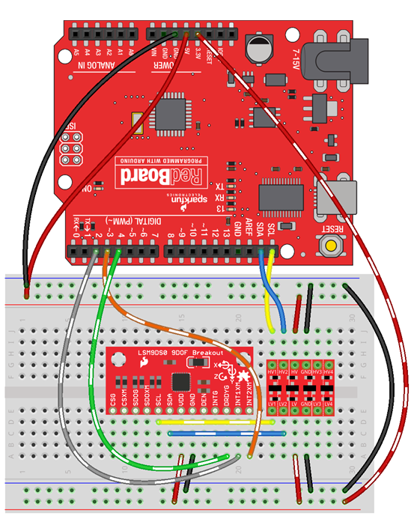
Analogue Position Feedback
Analogue Position Feedback
7-12V Power Source
Lower Servo Motor
Upper Servo Motor
PWM Signal
PWM Signal
USB
5V Rail
5V Rail
Ground
Ground
Ground
3.3V Rail

